Slide 1
Puerperium
Definition: the period after parturition when the reproductive tract returns to its non-pregnant condition so the female can become pregnant again (the period between parturition and return to the normal cycling state of the ovaries and uterus)
It begins immediately after parturition and recovery period varies among species
Short and smooth recovery period is desirable

Slide 2
Events during puerperium
Involution
Restoration of the endometrium
Return to cyclic activity/ ovarian rebound
Elimination of bacterial contamination

Slide 3
Uterine involution
Involution refers to reduction of size of the genital tract
Involves uterine contractions, physical shrinkage, necrosis and sloughing off of the caruncles and regeneration of the endometrium

Slide 4
Main areas of activity
Physical shrinkage and atrophy of tubular genitalia
Restoration of structure of endometrium and deeper structures
Resumption of ovarian function in polyestrous spp and return to cyclical activity
Elimination of bacterial contamination of the uterine lumen

Slide 5
Uterine contractions
Uterine contractions continue for 3 days
Time pp | Frequency | Duration
1st day | Every 3 min | For 1.5 min
2nd day | Every 8-12 min | For less than1/2 min
3rd day | Irregular
6th day | Complete stop of uterine contractions
Treatment with oestradiol and dexamethasone prolong uterine contraction for 48h

Slide 6
Aims of uterine contractions
Shrinkage of tubular genitalia
Restoration of endometrium
Elimination of bacterial contamination
Resumption of normal ovarian function
Involution occur in myometrium endometrium and blood vessels

Slide 7
Restoration of endometrium
7-10 days pp there is noticeable loss of fluid and tissue debris referred to as secondary cleansing
Endometrial repair occurs through:
  Necrosis of caruncular tissues
  Sloughing of caruncular tissues
  Reorganization of uterine endometrium

Slide 8
Cow
Stimulus for the changes that occur during the puerperium is primarily due to the removal of the foetus.
Hormones such as oxytocin and prostaglandin F2α (PGF2α) are involved.
For PGF2α there is an increase after the end of parturition, in which peak values occur 3 days postpartum and do not return to basal levels until 15 days postpartum.

Slide 9
1: Involution
Def: the reduction in size of the genital tract
Occurs in a decreasing logarithmic scale
Greatest change occurs in the first few days
Uterine contractions that reduce in regularity, frequency, amplitude and duration
Diameter of gravid horn is halved by 5 days and length halved by 15 days
Whole uterus is palpable per rectum 8-10 days pp in primipara and pluripara animals respectively
Speed of involution in nongravid horn is variable depending on the degree of placenta involvement
Dairy cattle, involution is complete between 26-52 days, beef 37-56 days

Slide 10
Cervix
10-12 hrs after normal calving its almost impossible to insert a hand
96 hrs- admits just two fingers
Cervix undergoes atrophy and shrinkage due to elimination of fluids and reduction in collagen and smooth muscle
Mean internal diameters
    15cm-2days pp
    9-11cm-10days pp
    7-8cm-30days pp
    5-6cm-60days pp

Slide 11
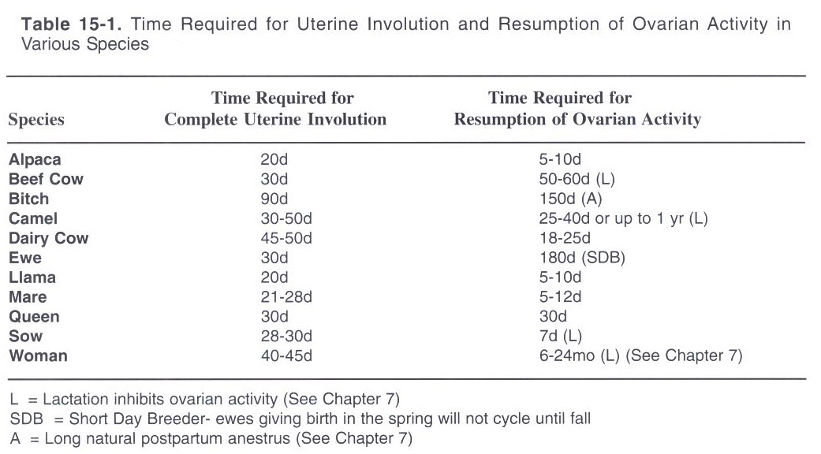

Slide 12
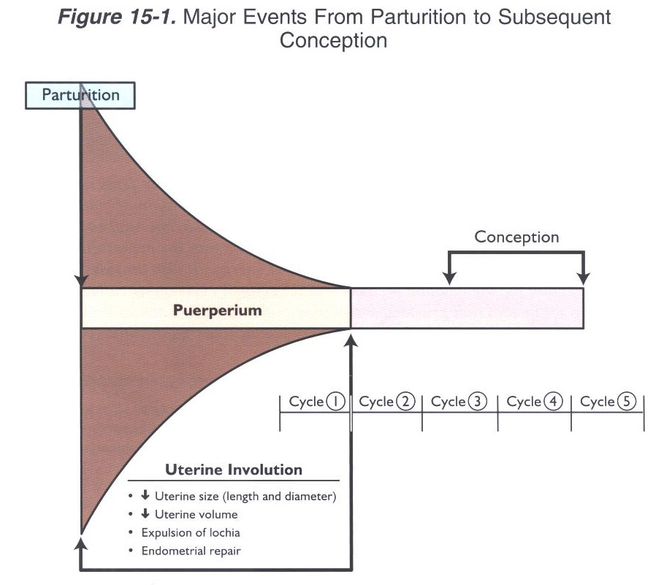

Slide 13
Myometrial contractions
Reduction in uterine size and volume is brought about by myometrial contractions.
① Discharge of fluids and tissue debris from the uterus;
② Compress the uterine vasculature and minimize the possibility of hemorrhage;
③ Reduce the overall size of the uterus;
In suckled animals, suckling reflex stimulates uterine contractions by the release of oxytocin from the Posterior Pituitary (originating from the PVN in the hypothalamus)
Dairy (episode 2-3 times/day)
Beef (episode 6-12 times/day or more)

Slide 14
Cont’
For Dairy Cow, delayed uterine involution is an important factor limiting fertility.
Calf removed within 24hrs after parturition;
Only 2-3 times milking per day
Oxytocin episodes are reduced, therefore, myometrial contractions are not as frequent and uterine involution can be delayed.

Slide 15
Cont’
During and after myometrial contractions, a bloody fluid is discharged from the tract.
Lochia: contains remnants of the foetal placenta, endometrial tissue, blood, necrotic tissue and mucus after parturition.

Slide 16
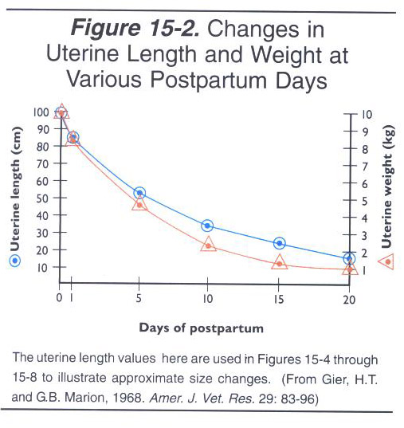
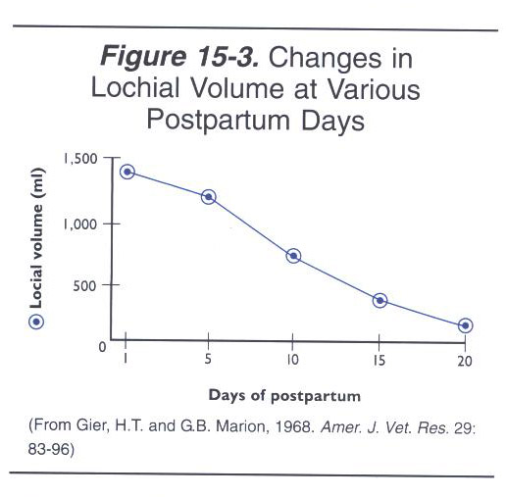
Stage 1: Myometrium contraction and expulsion of lochia

Slide 17
2: Restoration of the endometrium
Noticeable loss of fluids first 7-10 days “second cleansing/secundus/lochia”
Lochial discharge is usually yellowish brown/reddish brown, volume varies with individuals
  Pluripara can void up to 2liters
  Primipara 500ml
  Some animals void nothing due to re-absorption
  The greatest flow of lochia occurs 2-3 days pp, reduces by day 8, virtually disappeared by day 14-18 pp
  Its blood stained at day 9, lymphlike as it disappears, and no unpleasant smell

Slide 18
Its derived from
  remains of foetal fluids,
  blood from ruptured umbilical vessels
  shreds of foetal membranes
  sloughed surfaces of the uterine caruncles
  Degenerative changes and necrosis of superficial layer
  First 48 hrs early necrotic changes within the septal mass of the caruncles observed, caruncular bld vessels are constricted and almost occluded
  Day 5, stratum compactum is covered by a leucocyte-laden necrtotic layer.
  Sloughing off happens
  Arterioles then protrude to the surface of the caruncle and ooze bld
  Day 10, necrotic tissue has sloughed off and slightly liquified
  Day 15, sloughing complete, leaving only stubs of bld vss
  This smoothens by day 19

Slide 19
  Intercaruncular spaces= less damage= complete healing by day 8
  Complete re-epithelialization of the caruncle coming from centripetal growth of cells from sorrounding uterine glands is complete by day 25,by day 40-60 only small protrussions are left 4-8 mm diameter
For dairy cow: )
a) lochial discharge occurs between 2-9 day;
b) By 14-18 days, almost nonexistent

Slide 20
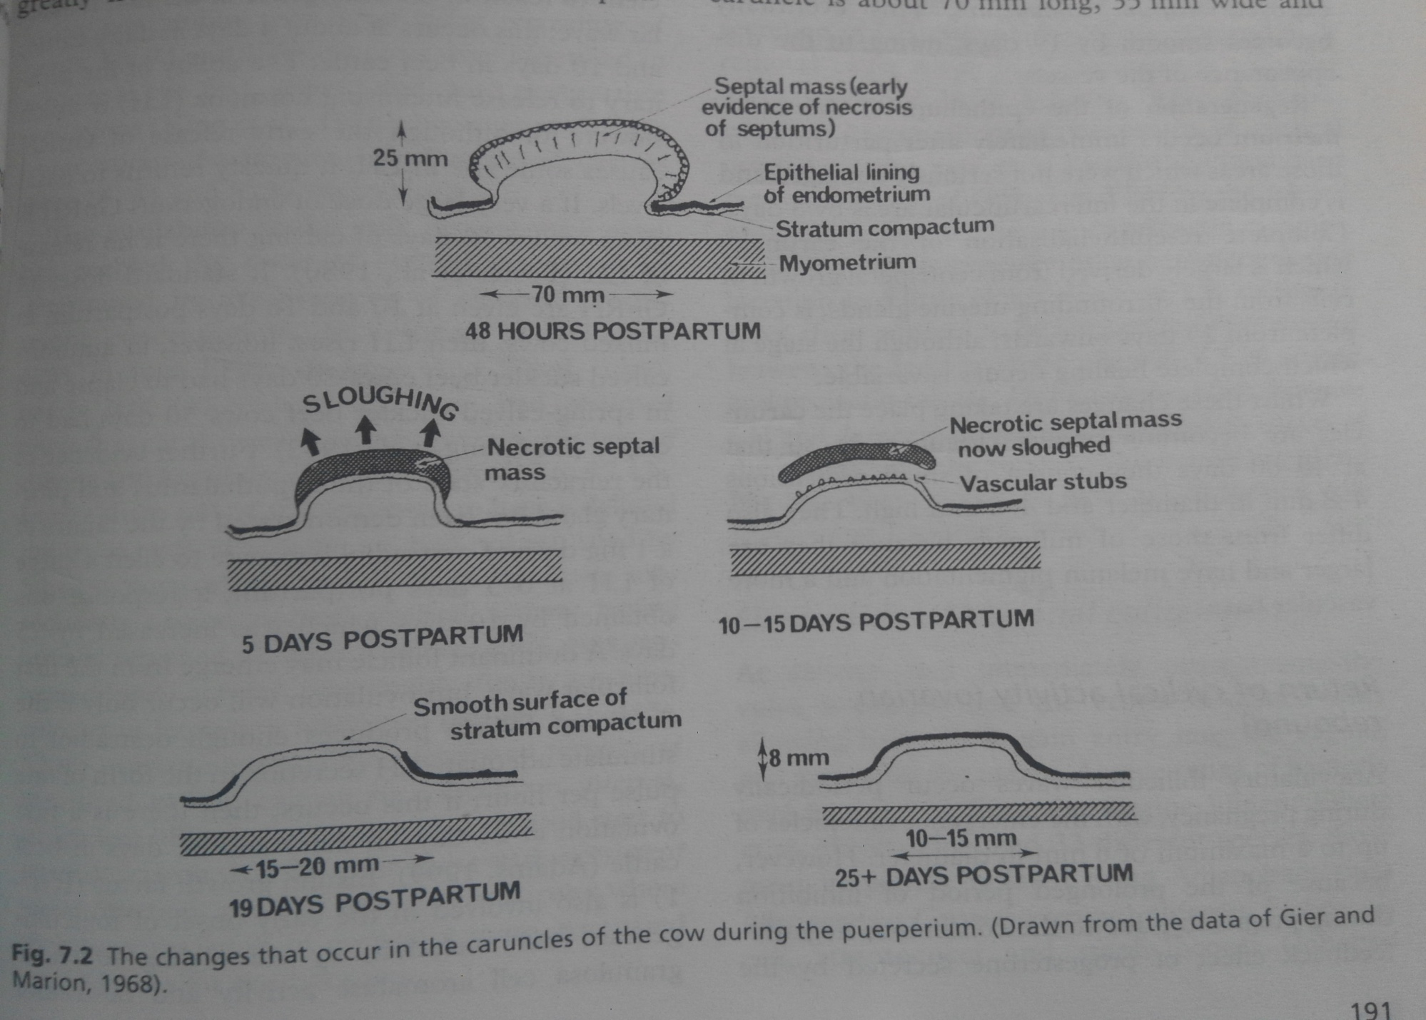

Slide 21
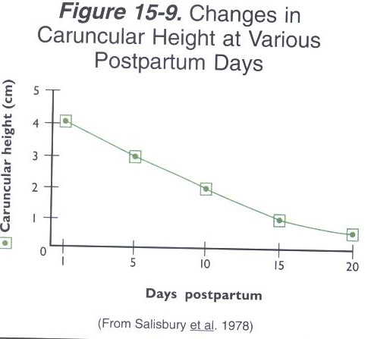
Endometrial repair
  The uterus undergoes atrophy, and decreases in size thru re-absorption of cells, diminished cellular proliferation, decreased cell volume, etc.
  Necrosis and sloughing off of caruncular tissues
  followed by Reorganization of uterine endometrium by the regeneration of the epithelial lining/covering over the surface of the endometrium in preparation for another pregnancy

Slide 22
3:Return to cyclic activity/ ovarian rebound
Continuous negative feedback by p4 during pg, the pituitary is refractory post-partum
Ovary is quiescent, prolonged in suckler and high yielding animals= anoestrous
Recovers with time
Pp phase, ovaries have large anovulatory follicles that atrophy
Immediate pp period, gonadal hormones are low
7-10 days, endogenous GnRH is enough to give sufficient FSH, dairy day 4 and beef day 7- emergence of a new wave
Ability to release LH about day 10 or 16 depending on strength of GnRH pulses
If a Dominant Follicle produces enough E2 there will be ovulation on day 21 and 31 dairy and beef respectively
Insulin growth factor 1- helps in early folliculogenesis and ovulation- stimulates granulosa cell aromatase activity and oestradiol synthesis

Slide 23
Ovarian rebound …………
This cycle is followed by a short lutea phase (14 days) in like 77% beef animals- due to luteinization of a non-ovulatory follicle or inadequate luteinization of CL.
Sign of first heat is not a sign of return of cyclical activity
CNS needs prior exposure to P4 to elicit behavioral oestrus
Some may be silent
Fertile oestrus by day 42
Ovary has involution CL which become a C albicans.

Slide 24
Ovarian rebound …………
Meeting reproductive targets
Lactational anoestrous- suspension of oestrus and ovulation during lactation
Inhibitory effect have been overcome through selection, improvement, nutrition and weaning (sow)
Day 50 pp, about 95% of the dairy cows have resumed ovarian activity, 40% beef cows.
  Most mares will show foaling heat in 7-13 days pp- routine to mate despite the low fertility
  Faster healing, type of placenta
  Sows- farrowing heat 3-7 days- ovarian heat- its ovulatory
  Weaning at any time induces fertile heat
  Sheep seasonal breeders/ lactational anoestrous coincides with seasonal anoestrous in template countries

Slide 25
Cont’
ACTH and corticosteroid administration surpresses LH
Stimulation of teat and milk removal causes rise in glucorcorticoids
Opiod antagonists increases LH and decreases prolactin and effects of agonist are reverse
Prolactin role to inhibition of hypothalamus

Slide 26
4: Elimination of bacterial contamination
Common in most domestic animals because parturition occurs in a non-sterile environment;
Vulva is open, cervix dilated
Not always associated with pathology;
Elimination of bacteria is through:-
Continued of uterine contraction
High degree of phagocytosis in the postpartum reproductive tract due to high concentration of estradiol;
Physical expulsion by help of all the debri and uterine secretions
Uterine infection results in:
  a) prolonged uterine involution;
  b) prolong the puerperium;
  c) delay of subsequent pregnancy;
  Major bacteria, Actinomyces, Corynebacterium, E coli, Streptococcus, Staphylococcus
Blood ,cell debri and sloughed caranculal tissue – culture of bacteria
Early return to oestrus helps E2 increases resistance to microbes

Slide 27
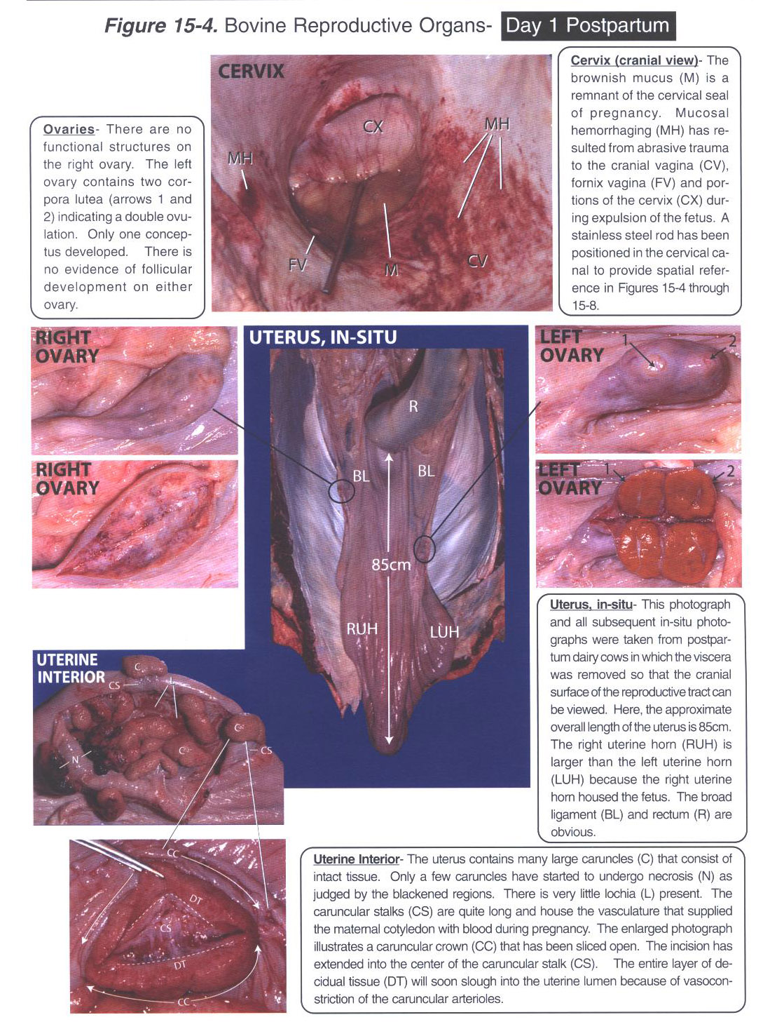

Slide 28
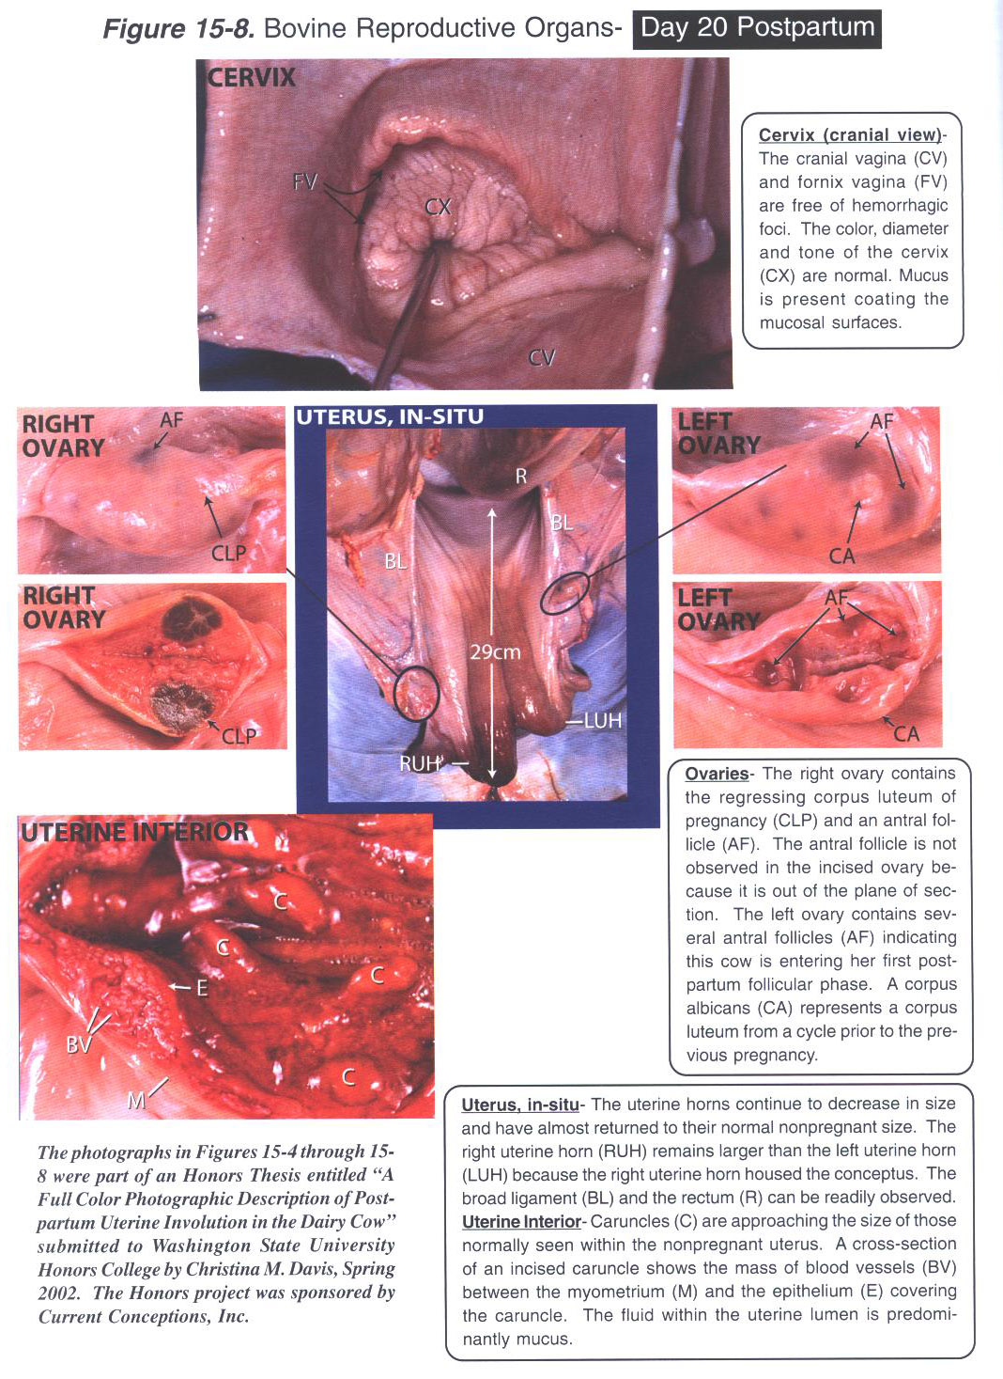

Slide 29
Factors influencing peurperium
Uterine involution- measured by ultrasonography
Age- primipara than prulipara
Season of the year- rapid in spring than summer
Suckling vs milking- results are contradictory, may be a breed influence on the effect of time to return to cyclical activity
Climate- heat stress can accelerate and inhibit the rate of involution
Periparturient abnormalities- dystocia , RAB, hypocalcemia, ketosis, twin calves, metritis delay involution - up to 5-8 days delay has been recorded
Delayed return to cyclical ovarian activity- inhibits involution

Slide 30
Restoration of endometrium
Little evidence however RAB and metritis inhibits healing whilst ovarian rebound to cyclical activity may influence

Slide 31
Return to cyclical activity (rebound)
Periparturient abnormalities- as above
Milk yield- hard to differentiate nutrition and milk yield, lactation preceeding calvine
Nutrition- inadequate feeding(energy) during dry period and pp inhibits ovarian rebound poor body condition slows folliculogenesis and ovulation pp. effects is mediated by insulin and IGFs
Breed- beef vs dairy
Parity- delay in primipara compared to pluripara up to 4 lactations, nutrition, milk yeild and weight loss
Season of the year- photoperiodic effect
Climate- tropical climates show delay
Suckling intensity n milking frequency- the longer and the more intense the longer the delay

Slide 32
Elimination of bacterial contamination
Consequences of development of metritis and endometritis
Magnitude of bacterial load- massive bact flora may overwhelm natural defence mechanism
Nature of bacterial flora- many obligate grame- anaerobes (eg fusobacteruim, necrophorum, bacteroides) exhibit synergy with gram + aerobic bacteria
Delayed uterine involution
RAB
Calving trauma to uterus
Ovarian rebound- early RTE= early E2=more bacterial elimination but if there is more bacterial load and it persist to luteal phase then there will be massive growth due to P4

Slide 33
Puerperium on other spp
Mare
Its shorter than in the cow, with rapid involution and good conception at first heat pp
Pony mares- possible to identify the outline of the uterine body and horns by 12 hrs pp- longer in thoroughbreds
Lochial discharge slight and ceases by day 24-48 hrs-could persist up to a week
Uterine horns shrink rapidly, pregravid size by day 32
Non gravid horn shrinks slower
Cervix remains slightly dilated until after the first oestrus
Ovarian rebound is rapid, foal heat 5-12 days pp
Evidence of follicular activity by day 2- most mares will be fertile
Conception rates are poor even though the endometrium can sustain a pregnancy
Endometrium fully restored by 13-25 days pp

Slide 34
Endometrium
Small amounts of villous debris are frequently attached to the maternal crypts but are removed by autolysis
Maternal crypts disappear through lysis and shrinkage of the epithelial cells of the endometrium, condensation of their contents and collapse of the lumen of the crypts
By day 14 the endometrium is quite normal apart from some pleomorphism of the luminal epithelium, but in some mares the inflammation may persist for some weeks

Slide 35
Bacterial contamination
Major bacteria include β-hemolytic streptococci and coliforms
Mainly eliminated at the foal heat, if they disappear at the second pp oestrus
RAB delays involution, exercise hastens it
The process is more rapid in primipara than pluripara

Slide 36
Ewe and Doe
Puerperium is very similar to the cow
Being seasonal breeders, parturition is usually followed by anoestrous period
No info on the doe so what is described relates to the ewe though not much differences are expected.
INVOLUTION
Rapid shrinkage and contraction of the uterus particularly the first 3-10 days
According to measurements of uterine weight and length, involution is complete by 20-25 days, shown to be complete by 28 days in suckling ewes
Involution is due to collagen breakdown

Slide 37
Restoration of the endometrium
There is profound changes in the structure of the caruncle with degeneration of the surface, necrosis, sloughing off and subsequent regeneration of the superficial layer of endometrium
3days pre-partum, there is evidence of hyaline degeneration involving the connective tissue at the base of and next to the endometrial crypts
Arteries and veins at this sites will then be thinned
More degeneration of caruncular tissue occurs pp
There is ischemia at the base of maternal crypts, necrosis of surface layer of caruncle, autolysis and liquefaction by day 4, dark reddish lochia discharge.
Day 16, necrosis and total separation has occurred
Re-epithelialization of caruncular surface to finish by day 28
Lochial amounts is variable

Slide 38
Return to cyclic activity
Though they get to anoestrous, there is evidence of this happening within a few days to 2 weeks pp.
Follicular growth is common but ovulation is unusual
Inadequate LH due to deficiency of GnRH
Elimination of bacterial contamination
Some studies have not been able to isolate any bacteria from ewe 1-14 days pp- sterile

Slide 39
Sow
Involution
Rapid uterine weight loss first 5 days pp then a uniform involution that’s complete by day 28
After day 6, most of the wt loss is due to changes in myometrium mainly reduction in cell numbers, cell sizes and amount of connective tissue
Decrease in thickness of endo and myometrium is finished by day 28
Restoration of the endometrium
At day 1- evidence of extensive folding of the epithelium (columna),
Day 7- low flattened cells with signs of degeneration, No signs of cell division (regeneration)
Regeneration complete by day 21

Slide 40
Return to cyclical activity
Most cases there is no RTE till piglets are removed
The later the time of weaning the shorter the interval to first oestrus e.g. 2,13,24,35
The time to first ovulation can be shortened by temporal removal of the whole litter for varying period during the day (partial weaning) or permanent removal of part of the litter (split weaning)
Rapid CL regression to be dead by day 7, there is considerable follicular development during suckling (6-7mm) associated with behavioral oestrus shortly after farrowing with no ovulation
Inadequate GnRH release and synthesis, inadequate nutrition, severe wt loss can delay ovarian rebound
Exposure to the boar has a reverse effect

Slide 41
Bitch
Monocyclic, parturition is followed by anoestrous
Regression of C. lutea is rapid 1-2 wks they regress in size and measure 2.3mm in 3 months
Involution – horns on pregravid state in 4 wks
Lochia immediately pp is green and noticeable- presence of uteroverdin, and should change to bloodstained and mucoid in 12 hrs
In non-pregnant bitch, the surface of the endometrium undergoes desquamation followed by regeneration with repair complete in 120 days, in pp the time is 2 weeks longer
Areas of placental attachment are not identifiable easily immediately pp but are in 4 wks
Desquamation of epithelial lining starts 6 wks pp and is complete by 7 wks and whole regeneration is ended by 12 wks

Slide 42
Cat
Lactation will always suppress oestrus but if she has no kittens or has 1 or 2 she may show pp oestrus 7-10 day pp

Slide 43
Pp endocrinology
Pregnancy reduces the sensitivity of the pituitary to GnRH
The resumption of ovarian cyclicity depends on the establishment of a pulsatile pattern of LH secretion.
The observed delay is due, probably, to their being insufficient oestradiol to induce the pre-ovulatory LH surge
inhibition of the hypothalamo-pituitary axis preventing release of GnRH, FSH, LH
failure of the ovary to respond to gonadotropin by blocked gonadal activity

Slide 44
LH
Pulsatile pattern of LH secretion with a frequency of 0.25 to 1 per hour appears to be a prerequisite for the first ovulation postpartum
It is unlikely that teat manipulation alone can alter LH release patterns in the cow- factors, such as the presence of the calf or social interactions
Suckling reduces the frequency and amplitude of LH release, pituitary sensitivity to GnRH and the pulsatile release of GnRH by the hypothalamus

Slide 45
Estradiol
Early postpartum cow is sensitive to GnRH-induced gonadotrophin release and responds by secreting oestradiol.
Naturally E2 will rise few days pp then fall

Slide 46
Progesterone
Two types of luteal activity have been observed in the postpartum cow
short luteal phase and lasts 6 to 12 days- 50 to 80% of milked or suckled dairy cows
The second luteal phase lasts about 14 days and tends to have lower than normal progesterone levels.
There may be premature luteolysis due to PGF_{2α} synthesized after calving by caruncular uterine tissue
It has been suggested that oxytocin can increase production of PGFM (a metabolite of PGF_{2α}) and lead to earlier luteolysis

